Slide 1

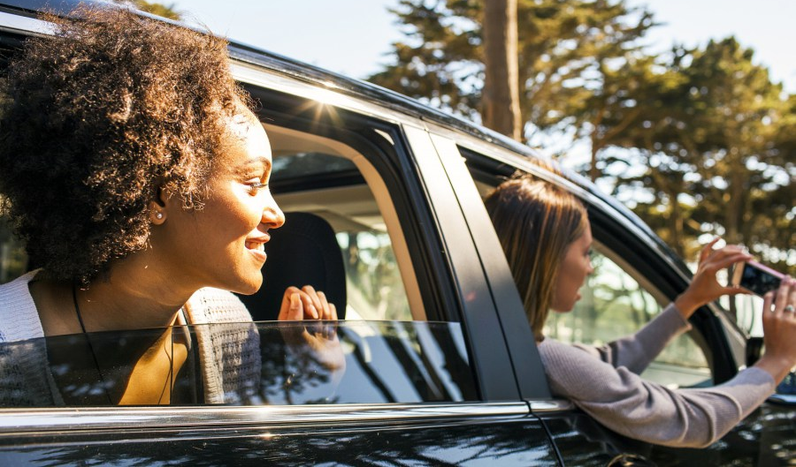

Where culture meets adventure,
one road trip at a time.
Team Aggie++
Angelica Willis, Ashana Evans, Brandon Long, Olivier Beya

Slide 2


173 million
Estimated number of road trips African Americans take every year
$1.3 Trillion
Estimated buying power of African Americans
6 Hours
The amount of time an African American dollar circulates in the community
80%
The number of African Americans that rely only on offline trip recommendations from friends and family
2
Opportunity

Slide 3

Have you ever…
Wanted to go on a spontaneous road trip?
Wished you had more opportunities to explore African American culture and history?
Wished you supported more minority owned businesses?
Notes:
http://nos.twnsnd.co/

Slide 4

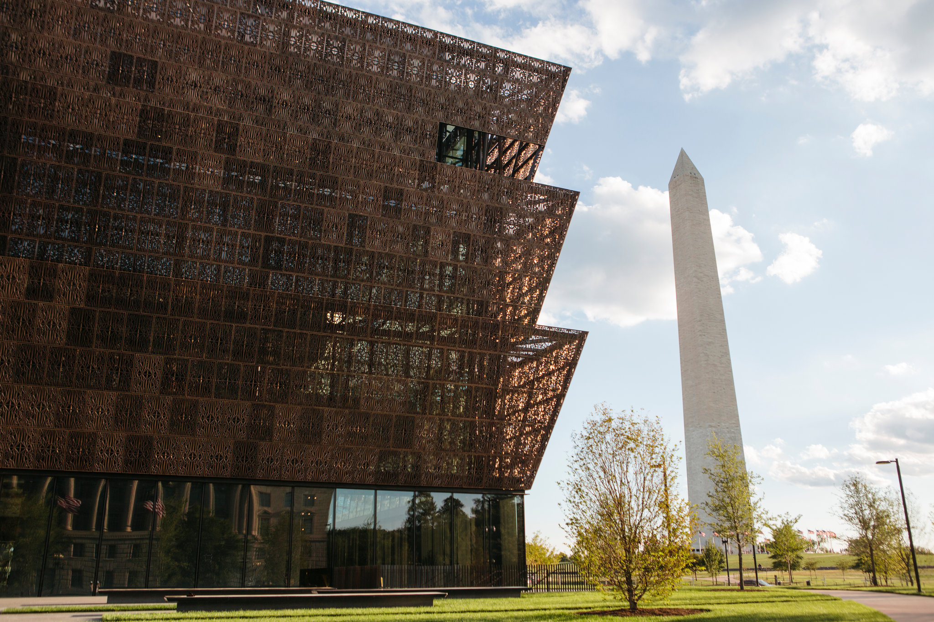

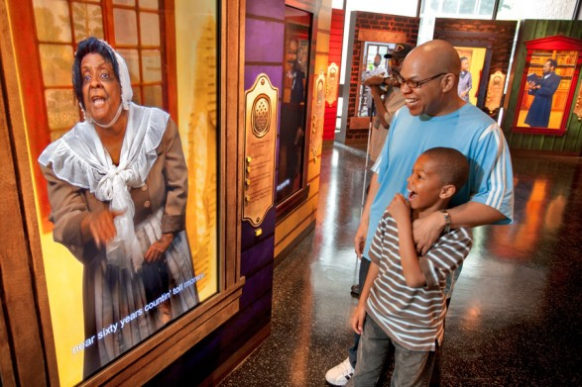

Exploring Black history and culture
Supporting Black owned small businesses
1
Solution

Slide 5
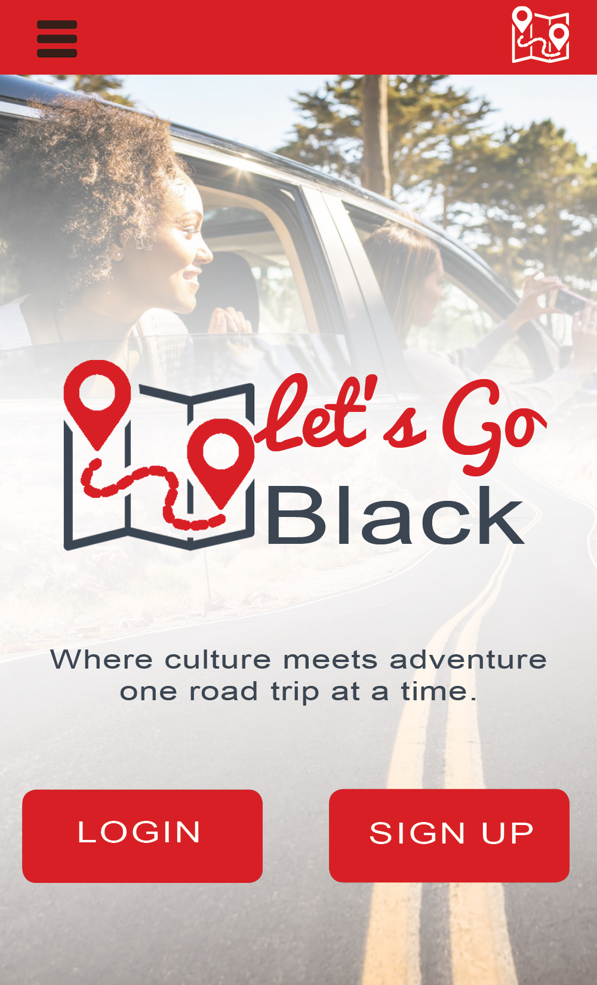
Product Features:
Simple sign up with the IDScan API.
Notifications when near one a partner business through the PlotProjects API.
The app will be able to handle millions of users through the use of the UserApp API.
Secure payment transactions using the Stripe API.
Developed using the Ionic Framework
3
Implementation

Slide 6
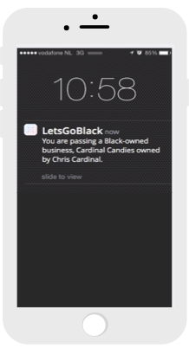
Let’s Go Black alerts users when they are close to an African American owned business
Geolocation

Slide 7

Economy + Education
1 Million Jobs
Amount of Jobs that could be created if African American Household spent only $1 of every $10 at Black owned businesses
Lets’ Go Black enriches the user’s African American cultural and historical knowledge and educates them on many great black businesses
4
The Impact
Notes:
Let’s Go Black has a direct impact on the African American community’s economy which in turn will impact the entire united state’s economy.

Slide 8



Revenue Model
+
=
Banner Advertisements
Paid Small Business Subscriptions
Cha-ching

Slide 9




4
Future Implementations
History and culture trivia/facts based on Geolocation
Rewards for buying from black business (coupons and discounts)
Partnerships

Slide 10
Q&A

